Slide 1

Ice SPEAR Ice Surface Penetration Experiment for Arctic Research
Critical Design Review
December 3rd, 2012
Christopher Allison Jordan Dickard Matthew Paley Chris Taylor
Isaac Hayden Elise Kowalski Jan Van Zeghbroeck Jordan Gomez
Notes:
Underline who is presenting

Slide 2
Outline
System and Project Overview
CONOPS – Technical Elements
Landing
Ice Penetration
Data Collection
Data Transmission
Manufacturing Plan
Testing Plan
Program Management Plan

Slide 3
Ice SPEAR
Landing
Penetration
Data Collection
Data Transmission

Slide 4
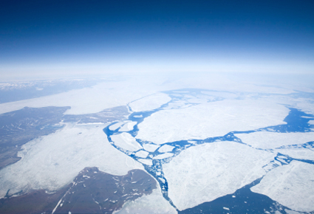

Objective
Design a sensor deployment system to measure ice and ocean characteristics in remote areas by surviving an airdrop landing, penetrating the ice to allow for representative sensor deployment, collecting data, and relaying that information 10 km for analysis.

Slide 5
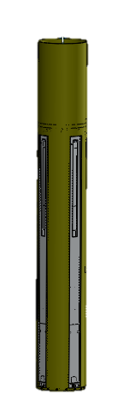
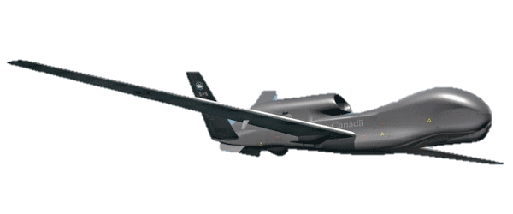
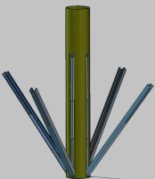
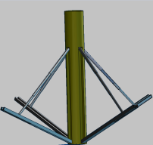
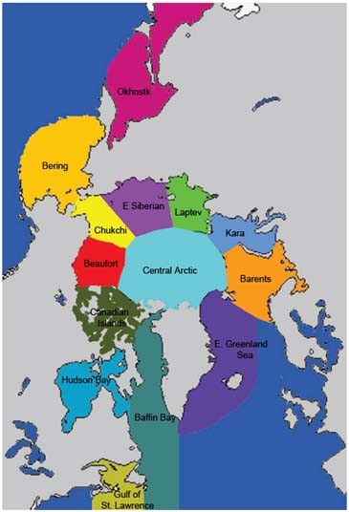

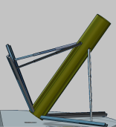
CONOPS – Landing
Mass
= 12Kg
900m
90 cm
13 cm
Wind = 6m/s
2.5 m/s
Brine Sea Ice

Slide 6

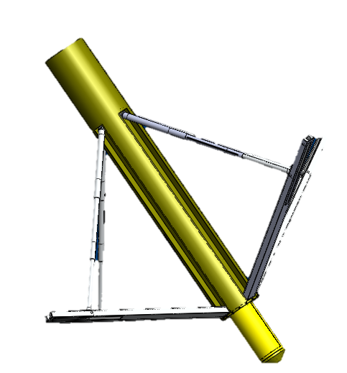
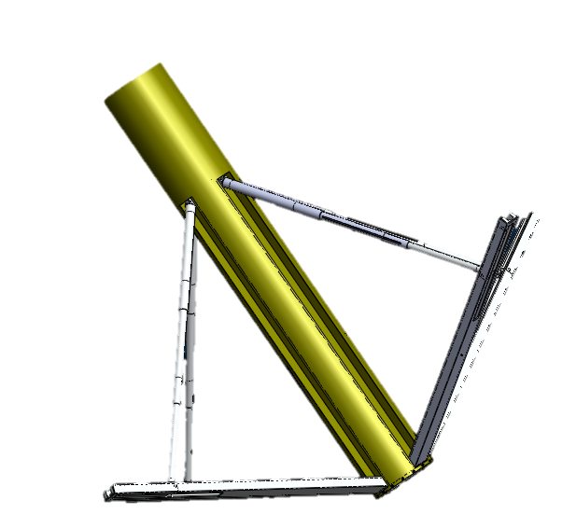
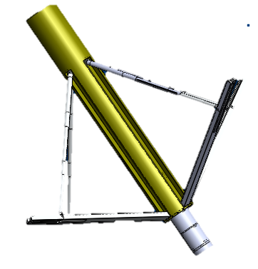
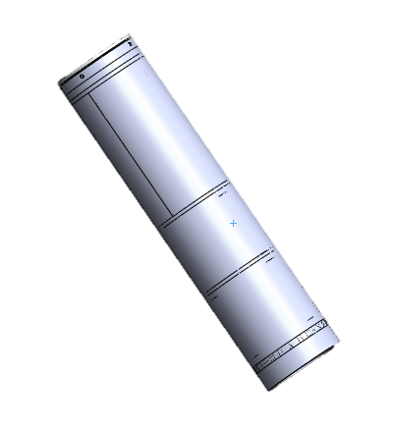
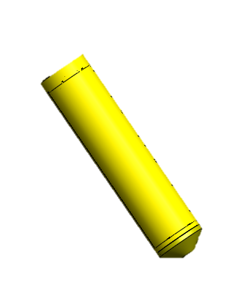
CONOPS – Penetration
Hole re-freeze = 25 min
= 12 hr
Brine Sea Ice
30 cm
Sea Water
Penetrator
Electronics

Slide 7
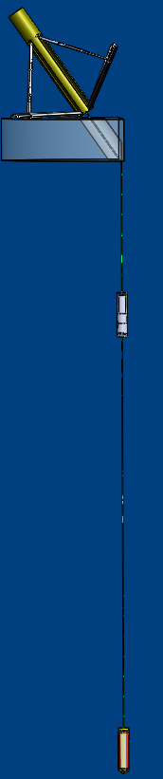
CONOPS – Data Collection
= 3 months
deployment in Oct.
Maximum Ice growth = 1.5 m
Electronics deployed 3 m
beneath surface structure
Water Temperature = -2°C to 2°C
Temperature sensor deployed 10 m
beneath surface structure

Slide 8
CONOPS – Data Collection
= 3 months
deployment in Oct.
Maximum Ice growth = 1.5 m
Electronics deployed 3 m
beneath surface structure
= Watertight
Water Temperature = -2°C to 2°C
= Comm
= C&DH
= EPS
= Data
= Power
Temperature sensor deployed 10 m
beneath surface structure

Slide 9
CONOPS – Data Collection
GPS data
= 3 months
deployment in Oct.
Maximum Ice growth = 1.5 m
Housekeeping
Data
Electronics deployed 3 m
beneath surface structure
= Watertight
Water Temperature = -2°C to 2°C
= Comm
= C&DH
= EPS
= Data
= Power
Temperature Data
Temperature sensor deployed 10 m
beneath surface structure

Slide 10
CONOPS – Data Collection
GPS data
= 3 months
deployment in Oct.
Maximum Ice growth = 1.5 m
Housekeeping
Data
Electronics deployed 3 m
beneath surface structure
= Watertight
Water Temperature = -2°C to 2°C
= Comm
= C&DH
= EPS
= Data
= Power
Temperature Data
Temperature sensor deployed 10 m
beneath surface structure

Slide 11
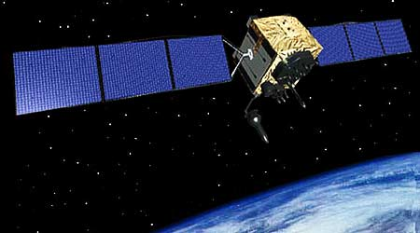
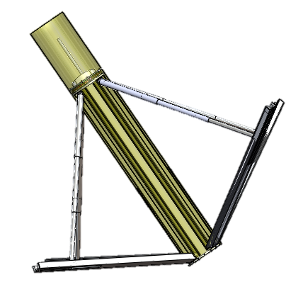
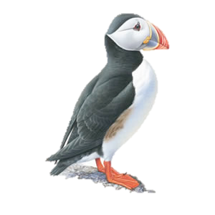
CONOPS – Data Transmission
10 km
= Comm
= Data
Brine Sea Ice
Sea water
Mission Timeframe

Slide 12
Ice SPEAR
Landing
Penetration
Data Collection
Data Transmission
Brine Sea Ice

Slide 13
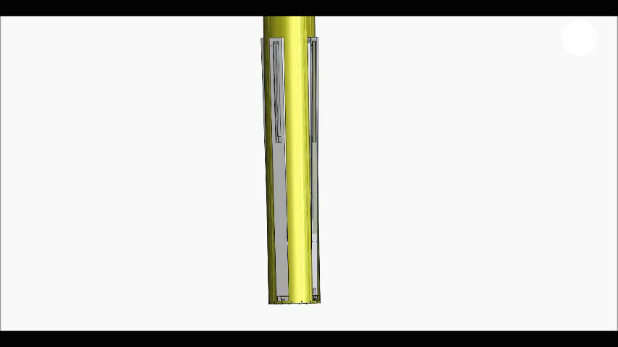
Landing legs unfolding
Lower
35x20x2 cm rectangular tube
Upper telescoping tubes
Compression spring in center
Pulled out using torsion + linear spring

Slide 14
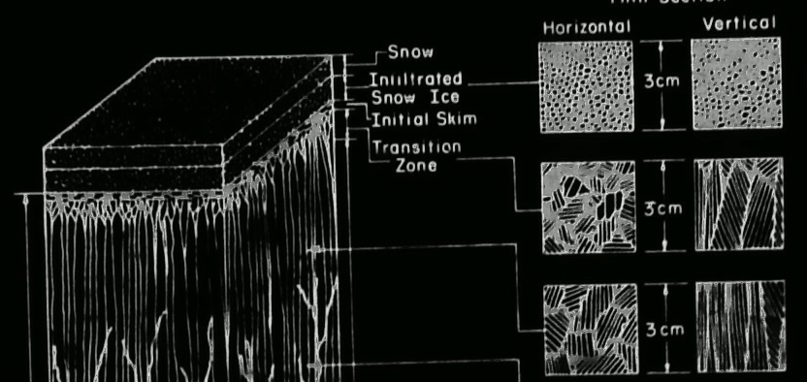
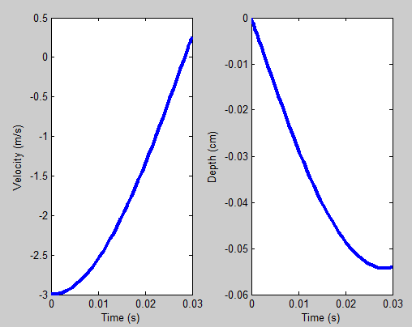
Ice Landing Conditions
Brine absorbs landing impact
Impact at 2.5 m/s
14 G’s deceleration in 5.5 cm
Aluminum plate is impact point
Brine Ice Layer
8 cm
Sea Ice
22 cm
Sea Water

Slide 15
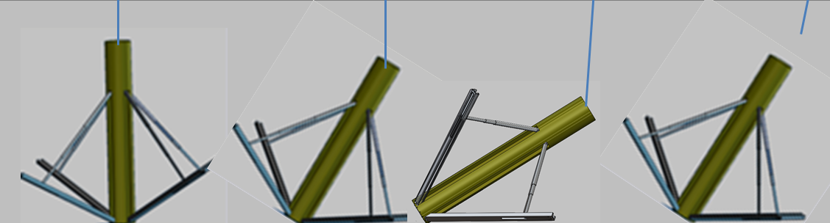
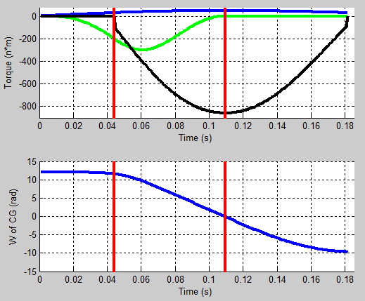
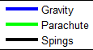
Landing
Horizontal velocity 6 m/s
CG velocity 6 m/s horizontal
Rotate to 35 degrees
19 G’s deceleration at 50 cm
35°

Slide 16
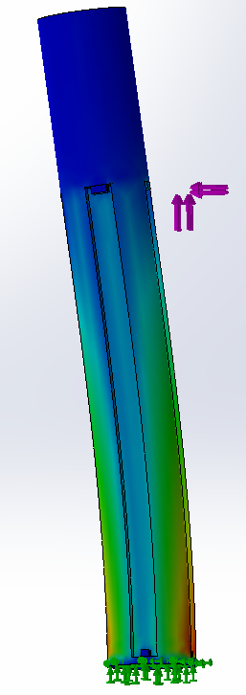
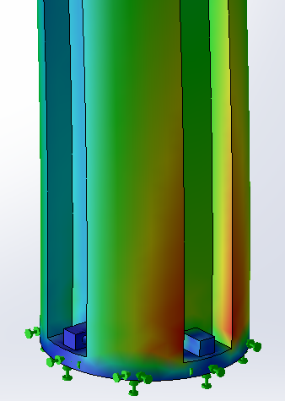
Structural Analysis
Force applied at leg connection
225 N (max force) at 55° from vertical
Maximum stress in simulation is 4 MPa
Fiberglass weave yield stress is 80 MPa
Second cloth layer for stiffness

Slide 17
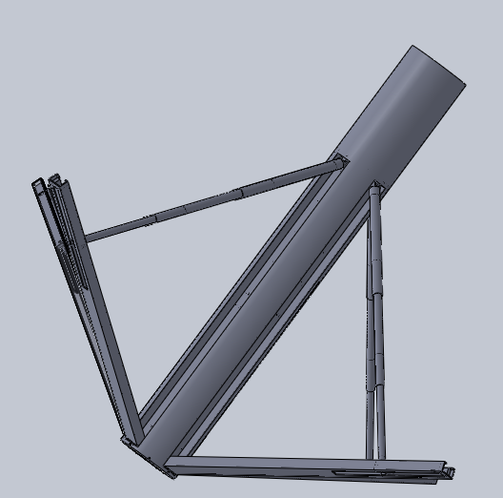

Upright/drag wind
Angle at drop
55° at landing
Horizontal velocity halted by brine layer
At 78 mph wind will rotate system
Storm Wind speed over Artic ice = 55 mph

Slide 18
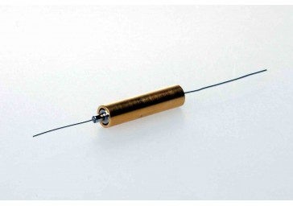
Landing: Software
How does the software start?
An inertia switch latches on impact
This closes a circuit to the microcontroller, turning it on
The microcontroller then starts the Initiation Sequence
Inertia switch closes on impact
Inertia switch completes circuit to microcontroller
Microcontroller turns on
Initiation Sequence is started
Start Software: Triggered By Impact
Penetrate Ice
Deploy Temperature Sensor
Do Health and Safety Check
Take data
Store data
Transmit data
Notes:
The trigger switch closes on impact. This sends a pulse to the microcontroller, turning it on. The microcontroller then starts the software.
Note: The “Start Ice Penetration sequence” box has a different shape than the other rectangular boxes. That is because it is another function—a deeper-level function. This type of box will be seen in more flow-charts later in this presentation and it will always mean the same thing: an additional function.
http://www.inertiaswitch.com/Unidirectionial-Latching-Normally-Open--17/

Slide 19
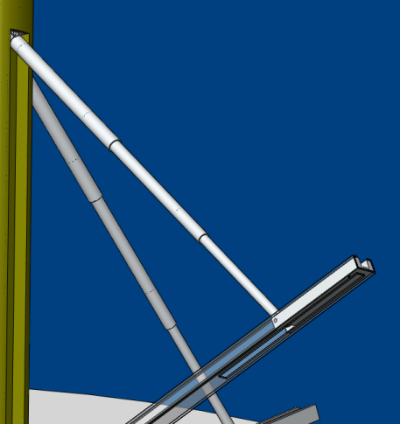
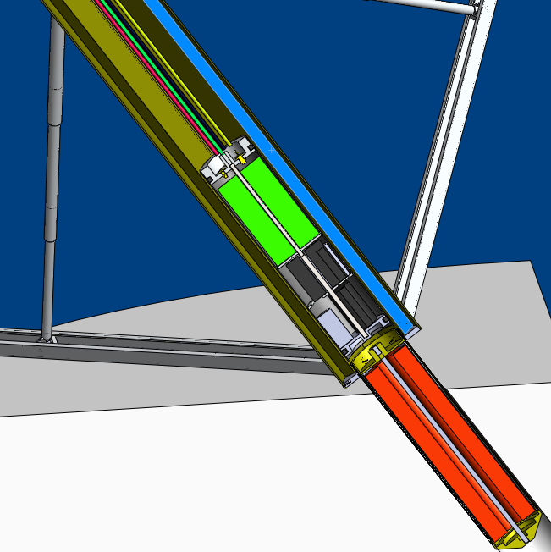
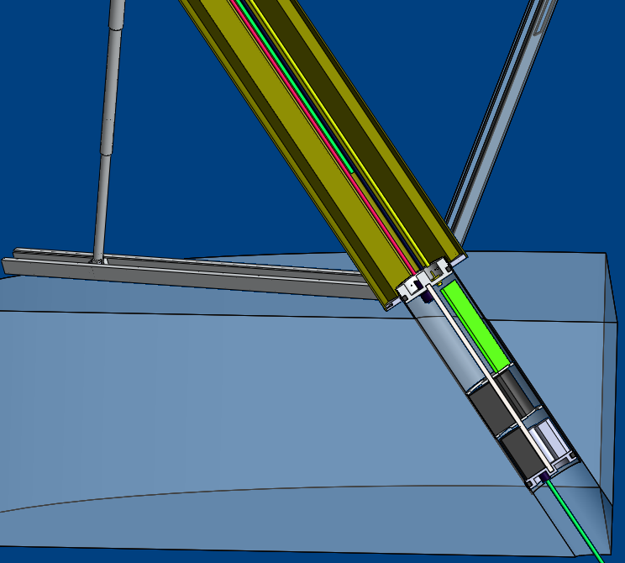
Binding
Two areas of concern
Traveler
3-1 ratio of length-width needed
4-1 in system
Deployment
Moment creates friction
Coefficient friction 0.2 (wax paper)
Friction > gravity at 5 cm left
Other half helps down to 1cm
Sliding tube 0.03 inches smaller
Slight rotation release

Slide 20
Ice SPEAR
Landing
Penetration
Sea Ice
Data Collection
Sea Water
Data Transmission

Slide 21
Deployment & Ignition: Software
Called from Initiation Sequence
Send data through low pass, anti-aliasing filter
Deploy penetrator by melting through nylon cord
Turn on HSTH-44000 temperature sensor
Light flares with Estes Rocket Igniters
Query HSTH-44000 temperature sensor
Send data through low pass filter
Convert analog to digital
Is temp. > 50 °C
Yes
No
Wait 20 min
Return to Initiation Sequence
Start Software: Triggered By Impact
Penetrate Ice
Deploy Temperature Sensor
Do Health and Safety Check
Take data
Store data
Transmit data

Slide 22
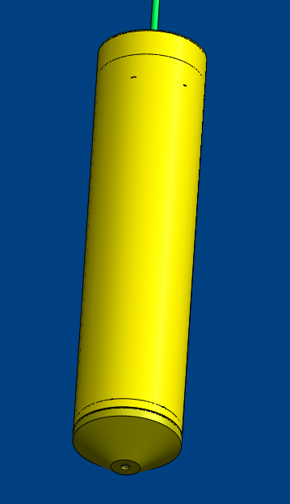
Final Penetrator Design
Cable to remaining systems
All Brass
Houses 6, 20 min flares
System Length: 32 cm
System Diameter: 7.62 cm
Internal hexagon-folded-sheet
Holds flares
Allows for gas to collect next to cylinder through vents
Gas escapes through the tip
Cap
32
cm
Tip
Notes:
Introduce slide as the final penetrator design.
Go through the design of the penetrator, always refer back towards the pictures
Note where it is in the system and how it deploys
Everything made of brass
Bass was chosen because it has a high melting point above the temp of flare, its strong enough that thin walled cylinders were available for the metal,
and a good thermal conductivity
Before mentioning internal hexagon-folded sheet next slide… ( to inside view)

Slide 23
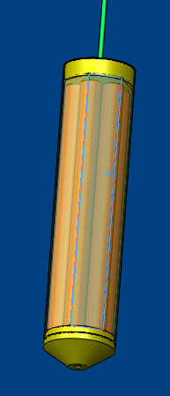
Final Penetrator Design
Cable to remaining systems
All Brass
Houses 6, 20 min flares
System Length: 32 cm
System Diameter: 7.62 cm
Internal hexagon-folded-sheet
Holds flares
Allows for gas to collect next to cylinder through vents
Gas escapes through the tip
Cap
32
cm
Tip
gas
Notes:
Mention that this is the inside view
Describe the hex sheet and what it does
- holds flares
Explain gas coming from flare filling up cavities in penetrator – especially vents between the hex-folded-sheet and the cylinder
to allow for best heat transfer to metal cylinder

Slide 24
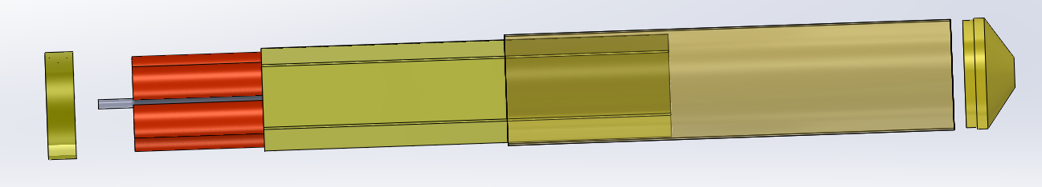
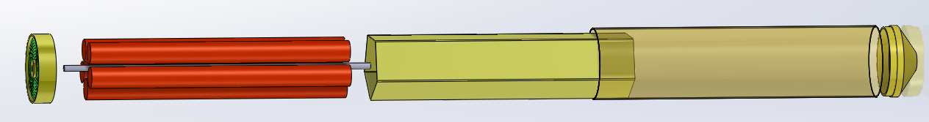
Final Penetrator Design
Pulled Apart View
Cap (7.62 cm d x 1 cm)
Center rod (0.635 cm d x 32 cm)
screws cap and tip to seal system together
Needs to be opened for reuse
6 Flares (2.29 cm d x 28 cm)
Hex-folded-sheet ( 3.7 cm side x 28 cm)
Mesh in between tip and cylinder
Ash and snuff mitigation
Holds flares and hex-folded-sheet
Tip (7.62 cm d x 2 cm)
Notes:
Continue of penetrator design
Mention that this slide has more dimensions and a pulled apart view to better see the construction of it
Must mention the center rod and how it connects everything
and the mesh in between the cylinder and tip to mitigate the flare ashes and snuffing

Slide 25
Flare Characterization Test
4 Different Tests
1. Flare in tight metal tube
2. Flare in spacious metal tube – no redirection
3. Flare in gas redirection configuration + mesh
4. Flare in water
Inconclusive results
Additional Tests
Starting flares with Estes rocket motor starters
Cutting flare
Water level
Clamp + Stand
Flare inside tube
+ Mesh
Metal tubes
Test # 3 Configuration
Notes:
Introduce slide – start of how the penetrator was designed
Explain simply each test and that they looked to find the heat flow of the flare system
For test one and two the flare was directly touching the metal
For test three also explain that we were looking as to whether redirecting the gas to transfer as much heat as possible from the gas to the system
additionally mention that a mesh was used to help mitigate the snuffing and ashes → point to figure
Briefly also mention that test four yielded inconclusive results and was not used in the designing process
Mention the additional tests and why we wanted to do them
start test to show it was possible
cut test to see if it would be possible to shorten flares for design purposes
Transition to results slide

Slide 26
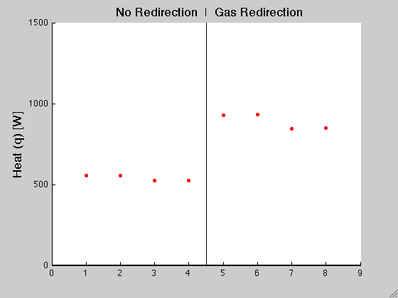
Flare Test: Results
Test 1: Initial Test
Tight spaces snuffed flare from contact
Shortened duration
Test 2: No Redirection
Produced low q = 539 W
Test 3: Gas Redirection
Mesh prevented snuffing
Higher q = 889 W
Also Learned
Cutting back end works
Estes Starters work
Flares burned longer than expected
Notes:
-Introduce slide as results and conclusions of the tests
-Explain the results of each test
-In test three the mesh mitigated the risks of snuffing and ashes as predicted
-because the ashes fly out as liquid drops from the tip of the flare and the mesh prevents them from sticking to the side of the tube and hardening and clogging
-Mention the graph in relation to tests 2 and 3 and how the heat in test three is higher… → next slide

Slide 27
Flare Test: Results
Test 1: Initial Test
Tight spaces snuffed flare from contact
Shortened duration
Test 2: No Redirection
Produced low q = 539 W
Test 3: Gas Redirection
Mesh prevented snuffing
Higher q = 889 W
Also Learned
Cutting back end works
Estes Starters work
Flares burned longer than expected
40% More Heat!
Notes:
… by 40% showing that redirecting the gasses to the tip and then letting it escape out the sides caused more heat
Mention all the additionally learned things about the flare
- observations of the flare including a better understanding of how they start, how they burn under water, how to start them
- Average burn time was 16 min so an extra min
Other notes: start flares by creating small hole in tip of flare and then insert starter and add current
The first ~45sec is the starting phase of the flare, seems to be a different reaction that is not water proof (second/main reaction is water proof)

Slide 28
Flare Thermal Model
Heat flow = Mass flow · Specific heat · Temperature change
dq/dt = dm/dt · C_{p} · ΔT
Assumptions
Heat is evenly distributed across penetrator
All heat transferred to ice
Gas redirection configuration in test 3 is worst case scenario
Worst case penetration distance of 37 cm
Constant Specific Heat and worst case ice properties
Metal is in constant contact with ice
Ice melts to water but does not boil
Flare produces constant heat flow
Penetrates at constant speed
Penetrator
Ice
Heat Flow
Water
Notes:
Quick slide:
Introduce that a thermo model was created using the results from the test
To accurately model the melting of ice using the heat of the flares is very complicated so manipulating simple equations of heat seen at the top a model was created
Figure on the right shows a simple control diagram of the model
On the left shows the assumptions made
The colors indicates as follows
Red: negatively impacts our system
Green: positively impacts our system
White: unknown or little effect to our system
Emphasize the ones in red as they will show up again in the second stage of the thermo model

Slide 29
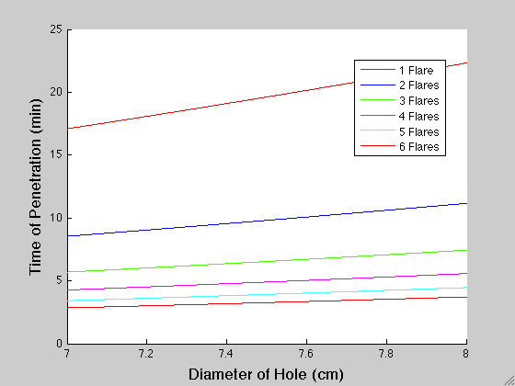
Flare Thermal Model and Design Points
Notes:
Introduce this slide as the results of the thermo model
Mention the x and y axis and the lines being contributed the heat flow shown in number of flares
Mention the trend and principle
of the faster the time of penetration the smaller the hole made
Also mention the trend of the more heat we have the quicker penetration can happen for a given hole diameter
Transition: In order to create a design from this plot we need some design constraints…

Slide 30

Flare Thermal Model and Design Points
Max time of flare
Notes:
The first constraint is maximum time of the flare – we have to be the below this line
Continuing…

Slide 31

Flare Thermal Model and Design Points
Max time of flare
Diameter of penetrator = 7.62 cm
Notes:
The shape of our penetrator is 7.62 cm which dictates this line ideally we would like to be to on or to the right of this line
This gives us…

Slide 32
Flare Thermal Model and Design Points
Max time of flare
Design Options!
Diameter of penetrator = 7.62 cm
Notes:
These design points. Where 2 flares should be very feasible
Mention that 6 flares is the most that will fit in our size constraints
Lets take a closer look at those assumptions that were made earlier…

Slide 33
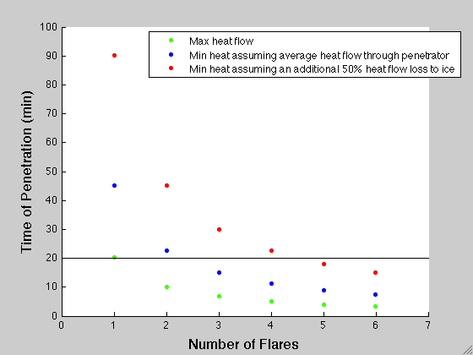
Flare Thermal Model: Estimated Heat Losses
Margin to ensure success
New technology
Many model assumptions
6 Flares
17% flare margin
25% time margin
24% depth margin
52° tolerance from vertical
11% larger hole diameter
Max ideal heat
Max time of flare
Notes:
Introduce the slide: this graph shows the penetration time vs the number of flare. The blue circle indicates the minimum number of
flares assuming maximum heat flow
If we take some losses into account…

Slide 34
Flare Thermal Model: Estimated Heat Losses
Margin to ensure success
New technology
Many model assumptions
6 Flares
17% flare margin
25% time margin
24% depth margin
52° tolerance from vertical
11% larger hole diameter
Heat is not evenly distributed across penetrator - average
Max time of flare
Notes:
Such as the heat no longer being evenly distributed across the penetrator because the heat flows from the tip of the flares
And heats the penetrator differently depending on the distance from the flares and the amount of air and metal in between
and instead assuming an average value
The heat requirements increase and 3 flares are now needed
Looking at another heat loss…

Slide 35
Flare Thermal Model: Estimated Heat Losses
Margin to ensure success
New technology
Many model assumptions
6 Flares
17% flare margin
25% time margin
24% depth margin
52° tolerance from vertical
11% larger hole diameter
Assume 50% heat transferred to ice
Max time of flare
Notes:
If we make the modest assumption that only 50% of the remaining heat actually flows to the ice
5 flares are required
(top right corner) but because using flares for this purpose is a new technology and incorporating all the other assumptions made a large margin
Is preferred
Hence…

Slide 36
Flare Thermal Model: Estimated Heat Losses
Margin to ensure success
New technology
Many model assumptions
6 Flares
17% flare margin
25% time margin
24% depth margin
52° tolerance from vertical
11% larger hole diameter
Max time of flare
Notes:
The choice to use the maximum 6 flares
This gives us a 17% flare margin (a full extra flare)
A 25% time margin (45% more time ~17min)
A 24% depth margin (Can penetrate up to 49cm)
And a 11% hole diameter margin to prevent binding (Max estimated hole diameter is 8.6 cm)
5 flares also an option in 6 flares is too tight in the system

Slide 37
Ice SPEAR
Landing
Penetration
Data Collection
Data Transmission

Slide 38
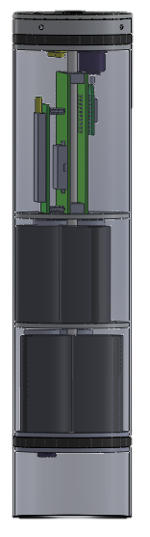
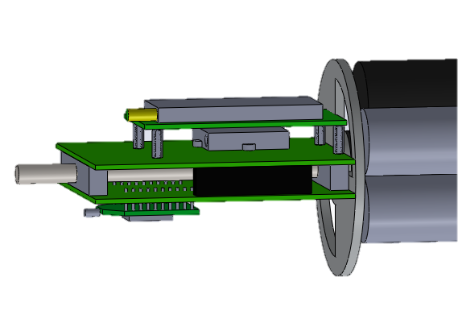
Electronics Structure
Threaded rod down center
Plates and plugs thread onto rod
Iridium modem
GPS
Threaded block
XBee system
24.5cm
7.62 cm

Slide 39
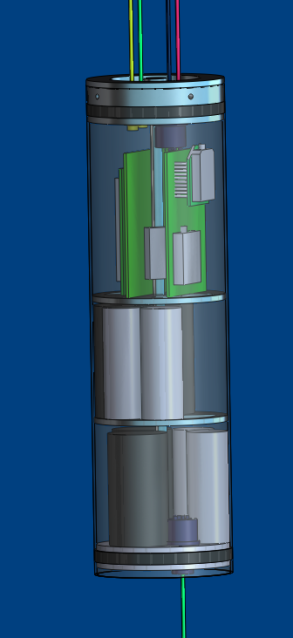
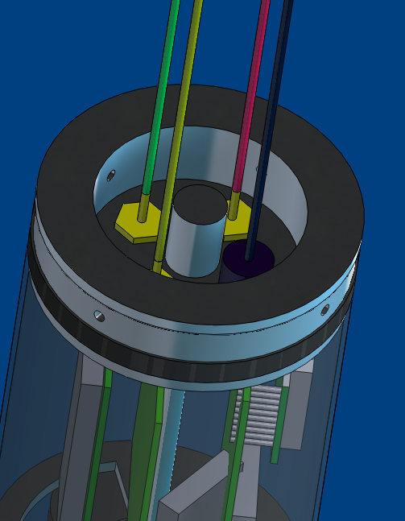
Waterproofing
Bulkhead connectors
3 RF cables
1 data line
Electrical components
Piston seal
Enclosed tube
Electrical connection
Data line

Slide 40
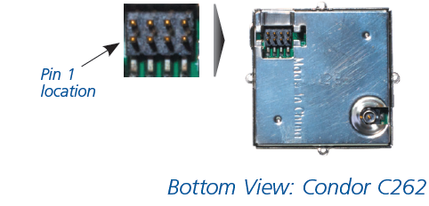
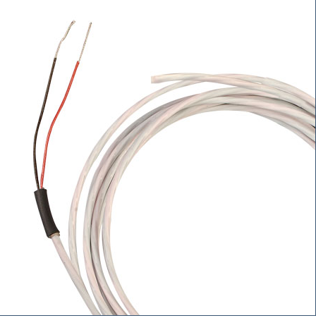
Data Collection
GPS Receiver – Trimble Condor C2626 Module
Requirements Met:
Accurate to 100 m radius
USART Communication
Temperature Sensor – HSTH 44031
Requirements Met:
Measure from -15º to +20º C
Accuracy of ± 0.1º C
Work down to 10 meter water depth
Housekeeping Sensors:
LM94022 – Temperature
HIH-5030 – Humidity
Vin
Vout
35 kΩ
R_{Thermistor}

Slide 41

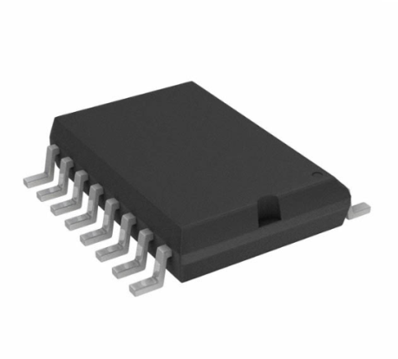
Data Processing
Microcontroller – PIC18F87K90
Control all electronic operations
Process GPS and Temperature Data; save to memory
Pull data from memory; send to radio for transmission upon request
2 USART and 2 SPI/I²C Ports
Flash Memory - SST25VF064C
64 Mbit Memory
14 mm

Slide 42
Data Collection & Storage: Software
Science Procedure
Called from Run-Time Loop
Send data through low pass, anti-aliasing filter
Store data in temporary variable ‘temp’
(12 bits)
Store system time in temporary variable ‘time’ (6 bits)
Store temperature and time stamp in temporary array (18 bits total)
Send data through low pass filter
Store array in flash memory in buffer location x
Query temperature sensor
Convert analog to digital
x =
x + 1
sci_count = 0
Return to Run-Time Loop
Start Software: Triggered By Impact
Penetrate Ice
Deploy Temperature Sensor
Do Health and Safety Check
Take data
Store data
Transmit data

Slide 43
Data Collection & Storage: Software
GPS Procedure
Called from Run-time loop
Query GPS
No
No
No
Store data in temporary variable ‘gps’
(16 bytes)
Did checksum pass?
Did fix pass?
Is number of satellites ≥ 4?
Store data in flash memory in page number x and buffer location 30
Yes
Yes
Yes
gps_count = 0
Return to Run-Time Loop
Start Software: Triggered By Impact
Penetrate Ice
Deploy Temperature Sensor
Do Health and Safety Check
Take data
Store data
Transmit data
Notes:
X is a global variable. It increments every time we take science data

Slide 44
Data Collection & Storage: Software
Housekeeping Data Procedure
Called from Run-Time Loop
Send data through low pass, anti-aliasing filter
Store data in temporary variable ‘hk_data’
(16 bytes)
Store array in flash memory in page number x and buffer location 158
Query temperature, humidity, and voltage sensors
Send data through low pass filter
Store data in temporary array (16 bits total)
Convert analog to digital
hk_count = 0
Return to Run-Time Loop
Start Software: Triggered By Impact
Penetrate Ice
Deploy Temperature Sensor
Do Health and Safety Check
Take data
Store data
Transmit data

Slide 45
Ice SPEAR
Landing
Penetration
Data Collection
Data Transmission
Sea Ice
Sea Water

Slide 46
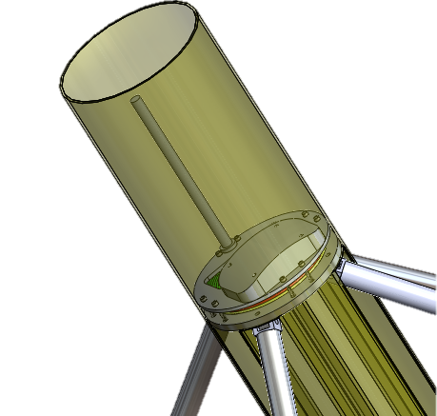

Antenna Locations
XBee Radio
GPS

Slide 47
Data Transmission: Software
Called from conditional statement
(10 Kbps)
(10 Kbps)
(10 Kbps)
Turn on Xbee transceiver
Listen for UAV signal
Is UAV nearby system?
Yes
Send signal to UAV announcing presence
Transmit data to UAV
Start timer
No
No
Is timer > 27 ms?
Yes
Turn off Xbee transceiver
End
Start Software: Triggered By Impact
Penetrate Ice
Deploy Temperature Sensor
Do Health and Safety Check
Take data
Store data
Transmit data

Slide 48
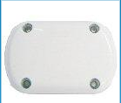
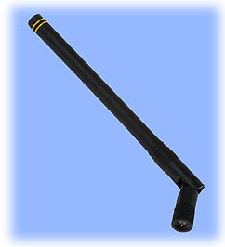
Data Transmission/Receiving
Two Antennas used
To receive GPS signals
BEAM RST703 Dual-Mode Antenna
Can be interfaced with Iridium
Active Antenna to overcome line loss
To Transmit and Receive information
ANTCOM Compact Dipole Antenna
Antennas placed on top of the outer system
Antennas placed maximum distance from
each other
Notes:
TBD figure out the interference issues
http://www.dpcav.com/xcart/900MHz-Antenna-Compact-Dipole.html
http://www.mackaysatellite.com/beam-accessory-rst703-dual-mode-antenna-bulkhead-patch-prev-rst903.html

Slide 49
Link Budget
Dipole ½ wave passive antenna
30 AWG at 3m long (TBF)
Baud Rate: 10kbps
Carrier Frequency: 928MHz
Parameters | Values
Transmitted Power | 250mw
Line Loss | 5.1 dB
EIRP | 18.88dB
FSPL | 111.79dB
Received Power | -92.91dBm
Receiver Sensitivity | 110dBm
Link Margin | 17.09dB
Notes:
EIRP = Equivalent Isotropically Radiated Power
FSPL = Free Space Path Loss

Slide 50
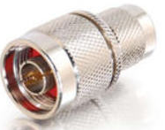
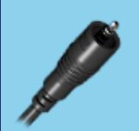
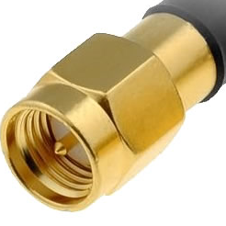
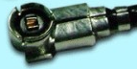
Data Transmission
Cable Selection
All RF lines will use a RG178 data line (30 AWG)
Selection derives from link budget parameters
Cable lines meet required specs of GPS/Iridium antenna
Can withstand up to 3Amps
50 ohm Impedance line
Connectors
SMA H.FL TNC Thermal
Notes:
To be posted: Thermal connector
http://www.google.com/imgres?um=1&hl=en&sa=N&tbo=d&biw=1243&bih=706&tbm=isch&tbnid=Abj1ESOOPm3oSM:&imgrefurl=http://www.simplesolutions-uk.com/products/rf/rf-antenna/868mhz-compact-antenna-sma-connector&docid=ES1bnnhRkkihqM&imgurl=http://www.simplesolutions-uk.com/files/product-images/sma-male_14.jpg&w=500&h=500&ei=IQa3UN6DMsXL2QWY7YDwCg&zoom=1&iact=hc&vpx=386&vpy=295&dur=2783&hovh=225&hovw=225&tx=155&ty=118&sig=115656840638623293590&page=2&tbnh=148&tbnw=144&start=19&ndsp=33&ved=1t:429,r:27,s:0,i:241
http://www.sears.com/shc/s/p_10153_12605_SPM6900448313P?sid=IDx20110310x00001i&srccode=cii_184425893&cpncode=31-55647029-2
http://www.google.com/imgres?imgurl=http://www.rfcoaxcable.com/mini_coaxial_cables/hirose_coax_cables/hirosehfl.jpg&imgrefurl=http://www.rfcoaxcable.com/mini_coaxial_cables/hirose_coax_cables/hrsh.fl_rf_coax_cable/hirose_h.fl_cable.html&h=300&w=300&sz=21&tbnid=0EQxsrgyYmk6rM:&tbnh=90&tbnw=90&zoom=1&usg=__YgUCluRJmhqZyH_QAC51Y1NBQSs=&docid=IW9WxcjuZHTaMM&sa=X&ei=Owe3UOf_OomrqAHisIHoBQ&ved=0CE4Q9QEwAw&dur=406

Slide 51

Component Layout

Slide 52
Component Layout
Microcontroller
PIC18F87K90

Slide 53
Component Layout
GPS
Condor C2626
Microcontroller
PIC18F87K90

Slide 54
Component Layout
GPS
Condor C2626
Microcontroller
PIC18F87K90
Transceiver
XBee XSC
HP900

Slide 55
Component Layout
Memory
SST25VF064C
Need: 0.5Mb
Stores: 8Mb
GPS
Condor C2626
Microcontroller
PIC18F87K90
Transceiver
XBee XSC
HP900

Slide 56


Power Layout
Low Power System
High Power System

Slide 57
Power Budget
Receiver duty cycle = 1% with 27s period

Slide 58
Energy Allocation
Batteries | Nominal Voltage (V) | Nominal Capacity (mAH) | Battery Temperature Efficiency | Battery Load Efficiency | Energy Available After Losses (J) | Energy Needed (J) | Expected Energy Use
LiThyCL | 3.6 | 18000 | 60% | 65% | 84000 | 9200 | 11%
LiPo | 6.4 | 3200 | 60% | 60% | 53000 | 24600 | 47%

Slide 59

Battery Harness
Lithium Thionyl Chloride
D | 33.6 mm
L | 59 mm
Setup | 4 in Parallel
Lithium Polymer
D | 26.2 mm
L | 65.0 mm
Setup | (2 in Series) in Parallel

Slide 60




Ice SPEAR
Manufacturing Plan
Testing Plan
Project Management Plan

Slide 61


Fiberglass Process
Cardboard
Laser cutter
Covered in wax paper
Jig is cheap (disposable)
Epoxy
8 oz fiberglass cloth
2 layers
No vacuum bag or kiln curing
Tolerance
Inner diameter 0.01 in
Grove dimensions 3.6 cm 2 cm

Slide 62



Main Machined Components
Part | Number needed | Machine | Picture
End plates | 3 | 4 axis CNC (Itll)
Plugs | 3 | Lathe
Tube ends | 8 | CNC or Bandsaw +mill
Traveler | 4 | Mill
Penetrator tip | 1 | Lathe
Plug block | 8 | Mill
Electrical plate | 2 | CNC

Slide 63

COTS parts
Telescoping tube
Springs (in legs)
Sliding track (modified)
Plastic tube
Threaded rod
Brass tube
Threaded rod
Brass sheet metal

Slide 64

Integration

Slide 65
Mass Budget
Sub-System | Assembly | Estimated Mass (g)
Mechanical | Penetrator | 2336
 | Structure | 3551
 | Mechanical Mass | 5887
Electronics | Communications | 257
 | Power | 360
 | C&DH (components) | 6
 | Sensors (wiring) | 173.8
 | Electronics Mass | 796.8
Total Estimated System Mass |  | 6683.8
Mass Requirement |  | 12000
Margin |  | 44.3%

Slide 66
Ice SPEAR
Manufacturing Plan
Testing Plan
Project Management Plan

Slide 67
Functional Test Plan
Component and Subsystem Test and Verification
System lead fills out test request form
Contains basics of what is desired in the test
Basic idea for set-up
Proposed budget
Testing Lead will coordinate writing of Test Procedures Document

Slide 68

Electronics, Software Integration Test
Test Goals
Verify:
Data collection capabilities
Waterproofing of system
Collection of housekeeping data to verify 90-day survivability
Data transmission, 10 km line of sight
Test Basics
Three hours of data collection
Temperature 10 times per hour
GPS and Housekeeping data once per hour
Transmit data when commanded by UAV electronics
Fly-over / Flagstaff Location
Temperature Sensor
Collect water temperature
Verify accuracy of sensor
Verify data collection
Housekeeping Sensors
Temperature: verify Ice SPEAR system temperature
Battery voltage measurements, verify battery levels as a function of time
UAV
Simulates UAV, which will be 10 km away, and will transmit a command to the Ice SPEAR system to transmit data

Slide 69
Water Depth Test
Test Goals
Verify waterproofing system at depth
Test Basics
Ocean First Divers, dive pool located in Boulder
Electronics and Penetrator portion of Ice SPEAR system manually released into pool
System nominally hangs on cables at a depth of three meters
Temperature sensor manually released, will sit on bottom of pool
Temperature sensor data collection, 10 times per hour
Housekeeping sensors collect data once per hour
Two hour test, remove system from pool and verify that system is dry.
Housekeeping sensor
Humidity sensor in lower section of Ice SPEAR, will verify that the electronics are dry
Ice SPEAR Mother-ship
12 foot deep dive tank
Ice SPEAR Electronics
Temperature Sensor

Slide 70
Below Ice Arctic Conditions Test
Test Goals
Verify:
data collection capabilities
waterproofing of system
90-day survivability of underwater electronics, using housekeeping data
Test Basics
Two day cold test
Collecting temperature data 10 times per hour and housekeeping data once per hour
Temperature Sensor
Collect water temperature
Verify accuracy of sensor
Verify data collection
Housekeeping Sensors
Temperature:
verify environment temperature
Battery voltage measurements:
verify battery levels as a function of time
Temperature Controlled Freezer
Ice SPEAR
Mother Ship
(contains housekeeping sensors)
Bucket
salt water
Ice SPEAR Electronics
Temperature Sensor

Slide 71
Above Ice Arctic Conditions Test
Test Goals
Verify:
data collection and transmission capabilities
verify 90-day survivability of communications antenna, using housekeeping data
Test Basics
Two day cold test
Collecting temperature data 10 times per hour and housekeeping data once per hour
Receive command from UAV after two days
Transmit data when commanded by UAV
Temperature Sensor
Collect and verify environment temperature
Verify data collection and create data for system to transmit
Housekeeping Sensor
Inside Ice SPEAR Electronics, used to verify container internal temperature
Heating Element
Maintain container at -10°C
Controlled by simple circuit, powered by separate battery
Communications Antenna
Container Temperature of -10°C
UAV Antenna
Environment Temperature of -40°C
Container Temperature of -10°C
Ice SPEAR Electronics
UAV
Electronics

Slide 72
Ice Penetration Test
Test Goals
Verify system capability to penetrate ice and deploy penetrator / electronics without binding
Verify:
thermodynamic ice melting model
flare ignition method
C&DH control over flare ignition
Penetrator
6 Flares, 20 minute burn
Releases exhaust
Test Basics
Temperature measurements of ice block immediately before test to align thermodynamic model
Barrel with water will catch system safely, will not melt
Time system penetration through 30 cm
Stretch goal of up to 50 cm
Ice Block
Purchased in Denver, taken out of cold storage and driven to Boulder Municipal Airport after test has been completely set up
Ice SPEAR
Ice Block
Ice Block
Salt
Water
Ice SPEAR Penetrator
Notes:
Ice Block: 101.6 cm x 50.8 cm x 24.5 cm
Clear ice, more dense than normal
Worst-case scenario

Slide 73
Impact Tests
Test Goals
Verify structural integrity and capability to survive 2.5 m/s impact
Test Basics
Two drop orientations
Vertical impact
Slight angle from vertical
Accelerometer attached to system, connected to a NI DAQ, data for real time analysis in LabView
Brine simulant: Ice chips mixed with salt water and partially frozen
Accelerometer
Collect deceleration data, with a sampling rate of 100 Hz
Test Goals
Verify structural integrity, and
capability to survive angular impact
Test Basics
Angular impact velocities, 5-15 rad/s
Two accelerometers attached to
system and connected to a NI DAQ,
data collected in real time on laptop using LabView
Ice block used as impact surface
Accelerometer
Collect deceleration data, with a sampling rate of 100 Hz
Motor / Torsion Spring
Capable of generating up to 45 Nm of torque
Speed controllable by control over when the lever arm releases the system
If motor is used, additional control gained over torque applied
Structural mock-up / Ice SPEAR system
Drop height
Ice Brine Simulant
Ground
Ice SPEAR
Ice SPEAR
Ice SPEAR
Ice Block
Ground

Slide 74
Testing Flow
Subsystem and Assembly Verification Tests
Design Verification
Component Verification
Assembly Integration Tests
Subsystem Integration Tests
System Integration Tests
Electronics, C&DH, and Communications
Water
Depth Test
Below Ice Cold Testing
Above Ice Cold Testing
Ice Penetration Test
Impact Test

Slide 75

Test Matrix

Slide 76
Ice SPEAR
Manufacturing Plan
Testing Plan
Project Management Plan

Slide 77
Feasibility
Penetration
Thermal model prediction validates design
System designed with 6 flares, provides margins
Mechanical
Impact Stress model shows structure survivability
Binding concerns mitigated through length ratio
Electronics
Commercial components, lots of room for PCB and wires
Support from Faculty and CCAR
Software
Initial code hierarchy complete, functions defined
Some CCAR drivers and functions can be leveraged

Slide 78
Risk
Risk | Mitigation
0.RSK.1 – Flare Ash | Design Solution: Mesh leaving cavity in the penetrator tip
0.RSK.2 – Flare Extinguishing
0.RSK.3 – Environmental Temperature | Design Solution: Utilize environment – sink sensitive components
0.RSK.4 – Electrical Power Needs | Design Solution: Multiple power supplies (2 kinds of batteries)
0.RSK.5 – Deployment Survivability | Design Solutions: Parachute – reduce final impact velocity Shock Absorbing Legs
0.RSK.6 – Full System Validation | Break in to smaller feasibility tests Testing locations found

Slide 79
Work Breakdown Structure
Ice SPEAR
PM
SE
I&T
SW
E&P
C&DH
Sensor
Comm
M&S
PMP
Requirements
Testing Procedures
Software Architecture
Power Budget
PCB
House-keeping Data
Link Budget
Structure Design
Project Success
System Architecture
Integration Procedures
System Health
Battery Harness
Electronics Layout
Science Sensors
Antennas
Penetrator Design
Design- to Specs
Safety Precautions
Power Layout
Cables
Design Alternatives
Solid Works
Landing Model
Design Approved
Order Materials
Machine Parts
Assemble
Test
Structure Design
M&S
Solid Works
Gas hole size
Design Approved
Order Materials
Machine Parts
Assemble
Test
Penetrator Design

Slide 80

Schedule

Slide 81
Critical Path

Slide 82
Budget
Subsystem | 100% | $ 8,111.00
Margin | 30% | $ 2,433.30
Electronics | 24% | $ 1,946.64
Mechanical | 10% | $ 811.10
Testing | 10% | $ 811.10
Shipping & Printing | 8% | $ 648.88
Redundancy Systems | 18% | $ 1,459.98

Slide 83
Back Up Slides
Others
Temperature Profile
Budget(3)
References(3)
Puffin Facts
Landing
Parachute Information
Parachute Model
Landing CONOPS
Penetration
Max Flare Temp
Test 4
Material Trade
Penetrator Trade Study
Structures
Landing on Sea Ice
Fiberglass Material
Telescoping Tube
Landing Springs
Holes Near Edge
Matching Plates
Travelers
Slots Fitting Locking
Lower Legs
Deployment Springs
Coil Calculator
Electric Unit
Bend Radius (top)
Wire Top
Tolerance in Outer Casing
Leg Open
Metric English Pivot
Galvanic Corrosion
Cold Welding
Vertical Impact
Fiberglass Justification
Electronics
Cables
Microcontroller
Voltage Regulator
Temperature Sensor
Antennas
Heat Dissipation
Optimizing Resolution
Resolution Design
Software
Functions
Housekeeping Sensors
Initiation Sequence
Main Run-Time Loop
Testing
Test Matrix 1
Test Matrix 2
Notes:
Housekeeping Sensors
Initiation Sequence
Main Run-Time Loop

Slide 84
References
Back
National Research Council Washington DC. Marine Board . Research in sea ice mechanics.
Melton, J. S. "Ductile Compressive Failure of Columnar Saline Ice under Triaxial Loading." Journal of Geophysical Reaserch 103.10 (1998): 21759-1766. Web.
"Samtec | Standard Board-to-Board." Samtec | Standard Board-to-Board. N.p., n.d. Web. 21 Nov. 2012. https://www.samtec.com/standardboardtoboard/default.aspx

Slide 85
References
Back
Dempsey, J. P., and Hayley H. Shen. IUTAM Symposium on Scaling Laws in Ice Mechanics and Ice Dynamics: Proceedings of the IUTAM Symposium Held in Fairbanks, Alaska, U.S.A., 13 - 16 June 2000. Dordrecht [u.a.: Kluwer Academic, 2001. Print.
"TAP General Purpose Epoxy : TAP Plastics." TAP General Purpose Epoxy : TAP Plastics. N.p., n.d. Web. 20 Nov. 2012. <http://www.tapplastics.com/product/fiberglass/epoxy_resins/tap_general_purpose_epoxy/28>

Slide 86
References
Back
"Quick Facts on Sea Ice." National Snow and Ice Data Center, n.d. Web. 28 Nov. 2012. <http://nsidc.org/cryosphere/quickfacts/seaice.html>.
OnlineMetals.com. N.p., n.d. Web. 25 Nov. 2012. <http://www.onlinemetals.com/index.cfm>.
MATWeb: Material Property Data. N.p., n.d. Web. 28 Nov. 2012. <matweb.com>.

Slide 87
References
Back
"Unidirectionial Latching Normally Open 6UO-920." Inertia Switch. N.p., n.d. Web. 12 Dec. 2012. <http://www.inertiaswitch.com/Unidirectionial-Latching-Normally-Open--17/>.
World Climate. N.p., n.d. Web. 27 Nov. 2012. <http://www.worldclimate.com/>.
"Monitoring the Arctic Sea Ice." Cold Regions Research and Engineering Laboratory, n.d. Web. 2012. <http://imb.crrel.usace.army.mil/>.

Slide 88
Temperature Profile
Back

Slide 89

Parachute Information
Back
$110
15 foot parachute
Designed for military flare
27 lb payload 3 m/s
12 kg payload 2.5 m/s
Package down to 5 in to 7 in volume
We will not be deploying or cutting parachute
Provide space for system to do it
Parachute cut once system has landed
http://aeroconsystems.com/cart/all-parachutes/15-foot-parachute/

Slide 90


Parachute Model
Back
Developed a model for landing condition
Model pendulum motion
Parachute must be well dampened
Landing angle depends on chute

Slide 91


Landing CONOPS
Back
1
Parachute and legs deploy
Landing condition 2.5 m/s vertical 6 m/s horizontal
Vertical contact
Rotation
Parachute release
2
1.5
3
5
4

Slide 92
Landing on Sea Ice
Back
Adviser
2x2 in area
150 lbs
Sinks 2 in deep
Assumed reaction force linear function of depth
Used ODE 45 to calculate depth impact
Sinks 5.5 cm
12 kg at 3 m/s
13 g impact

Slide 93


Fiberglass material
Back
Epoxy
Tap plastics General purpose
High strength flexibility
Simple to work with
1-1 ratio
Air dry
Cloth
Standard E Class Cloth
Heavy weight 9.75 oz
Made into our shape
Uniform thickness

Slide 94


Detailed Design: Telescoping Tube
Back
3 lengths
22-25 cm long
Grove in outer slot
0-80 bolt in smaller one
Prevents over extension
Outer diameter
0.634 -0.75 in
0.509 - 0.625 in
0.334 - 0.5 in

Slide 95

Detailed Design: Landing Spring
Back
Cut to length spring
60 cm long
Outer diameter 0.312 in
Spring constant 35.8 lb/in
Can be compressed to solid

Slide 96


Detailed Design: Holes near the edge
Back
Bottom plate 0.25 in
16 2-56 bolts
Concern
Fiberglass close to edge
Tension tests
10 tests
0.125 inch holes drilled
0.125 inches from edge
Held 8 kg average

Slide 97

Detailed Design: Machining plates
Back
Small blocks bolt onto plate
Simplifies machining
Cheaper, thinner metal
4 axis for holes along edge ITLL shop

Slide 98


Detailed Design: Traveler design
Back
1.55 cm by 30 mm 15 cm long
Ratio of 1-5 for binding
Al on Al 0.5 mm gap on each side
Lower tube fits into grove in stowed state

Slide 99

Detailed Design: Fitting into slots
Back
Slots
2.1 cm by 3.6 cm
Outer extrude
2 cm by 3.5 cm
2mm thick
Telescoping tubes inside

Slide 100

Detailed Design: Locking into slots
Back
Small bolt prevent over sliding
Spring plungers
2 spring plungers lock into holes in sliding rail
Prevent slider traveling back during landing

Slide 101

Detailed Design: Lower legs
Back
Torsion spring fits in to slot in pivot block
Force on lower plate and leg
Small hinge block

Slide 102


Detailed Design: Deployment springs
Back
Two springs
Torsion
0.42 in/lbs
Calculated torsion
Linear force
1.1 lbs force
Long enough to pull traveler
No normal force for friction

Slide 103
Detailed Design: Coil Calculator
Back
Inner Diameter
Matlab code
Takes in inner and outer diameter
Diameter of wire
Calculates size of coil
3 meters of cable
RF and data lines
Diameter about 0.2 cm
Outer Diameter = 12 cm
Inner Diameter = 6 cm
Five loops per layer
1.8 cm stack up
Height of wires
Outer Diameter

Slide 104

Detailed Design: Sinking the Electronic Unit
Back
Internal volume electrical unit
30 cm long
7.5 cm diameter
Volume= .0013 m³
Mass = 2.2 kg
Mass .0013 m³ water
1.325 kg
System will sink

Slide 105


Detailed Design: Bend Radius (top)
Back
Wires coming out of top have 0.60 inches to bend over into coil
Big coil on outside

Slide 106


Detailed Design: Wire Top
Back
Connection from XB has 0.75 inches for 90 degree connector to hook up
GPS + iridium plug allow for connection and for wire deployment

Slide 107
Detailed Design: Tolerance in outer Casing
Back
Thickness of material
1.2-1.5 mm
0.011 inches variation
Currently modeled as 2 mm thick
Mold will insure inner volume not to small
Leg inserts insure groves are large enough.

Slide 108

Detailed Design: Leg open
Back
Breakable cord when parachute deploys
Force from chute pulled over line
Cord is restraining legs
4 different lengths
Cord needs to
Hold 0.5 in/lb torque
24 in distance= 3.2 oz

Slide 109


Detailed Design: Metric English Pivot
Back
Privet diameter is 0.5 cm = 0.196 in
Drill with a 7/32 bit = 0.218
0.01 inch larger
Room to rotate smaller pin

Slide 110

Detailed Design: Galvanic Corrosion
Back
Penetrator all brass and steel
Electrical tube made from aluminum.
Clear tube to see wiring and shorting
Ground system to penetrator brass
7 m away will prevent corrosion

Slide 111
Cold Welding
Back
Bolts and plates join
Aluminum parts steel bolts
Slow insertion
Lubrication
Not over toque the bolts

Slide 112

Max Flare Temp in Metal Tube
Back

Slide 113


Test 4: Inconclusive Results
Back

Slide 114
Material Trade Study
Back
 | Al 6061 T6 | Cu 110 | Brass 260 | 304 Stainless Steel
Thermal Conductivity [W/(m K)] | 167 | 385 | 120 | 16.2
Melting Point [°C] | 582-651.2 | 1065-1083 | 915-955 | 1400-1455
Specific Heat [kJ/(kg °C)] | 0.896 | 0.385 | 0.375 | 0.500
Cost for ~ 12” x 12” x .1” | $12 | $72 | $62 | $31
Density (kg/m^3) | 2700 | 8890 | 8530 | 8000
Manufacturability | Good (50%) | Poor (20%) | Average (30%) | Good
Corrosion Resistance | Good | Excellent | Excellent | Excellent
In Order of Importance, Looking for:
High thermal conductivity
Melting point above flare Temperature
Low cost and density
High manufacturability and corrosion resistance

Slide 115
Penetrator Trade Study
Back
Aspect | Description | Choice | Reason
Flare Type | Road or Military flares | Road | Cheaper, easier to integrate and start, have enough heat
Breaker | Mitigates snuff/ash | Mesh | Best ash and snuff mitigation
Pusher | Moving flares | Weighted | Best ash and snuff mitigation
Size | Cut/Uncut | Uncut | Flares fit and full burn time is ideal
Theory | How the heat is best used | Gas | Experimentally Determined to have best heat flow
Design q | Heat flow of flare | 889 W | Experimentally Determined as worst case design heat flow
# Flares | Number of flares | 6 | Maximum that fit
Metal | Metal tip is made | Brass | High melting point and needed pieces were available
Starter | System to start flare | Estes Starters | Works well
Tip | Construction of the tip | Tube inside Tube | Allows for redirection of gas and best heat transfer

Slide 116




Design Specs: Cables
Back
3 RF cables
3 meters long
1 Xbee rado
1 GPS
1 iridium system
1.8 mm diameter
Bend radues 0.9 cm
Sample from Samtec
Connectors for all antenna ends
Data Cables
7 pin connector
7 data lines
-30°C
Watertight to 10 m
Calling about diameter

Slide 117


Design Specs: Microcontroller
Back
Will control all electronic operations
Chose PIC18F87K90 due to its:
Large RAM and Program Memory
2 SPI/I²C and 2 UART Ports
Low Current Draw of 1.2 mA

Slide 118


Design Specs: Voltage Regulator
Back
Bring down voltage to 3.3 V
Chose CAT6217-Due to
Low dropout voltage of 90 mA
Low ground current of 55 μA
Low operating current of 90 μA

Slide 119
Design Specs: Temperature Sensor
Back
Requirements for Temperature Sensing:
Measure from -15º to +20º C
Accuracy of ± 0.1º C
Work down to 10 meter water depth
Chose HSTH-44031 to Meet Requirements
(diameter of cable is .22 cm)
Vin
Vout
R

Slide 120


Design Specs: Antennas
Back
Active GPS/Iridium Antenna
Chose Beam RST903 due to:
Dual Functionality
Military Grade Temperature Range (-55°C)
SMS/TNC Connectors
Loading > 30 G
Passive RF Antenna
ANTCOM-900
55 mm
127 mm

Slide 121
Software: Functions
Back
Function | Purpose | Inputs | Outputs
Initiation | Calls Ignition, Deployment, Health and Safety, and Run-Time Loop procedures | NA | NA
Flare Ignition | Lights flare | NA | NA
Flare Deployment | Melts through nylon cord | NA | NA
Health and safety | Checks system temperatures and battery voltage | NA | NA
Run-Time | Calls Science, GPS, and housekeeping procedures | NA | NA
Science | Takes, filters, and saves science data | NA | NA
GPS | Takes, filters, and saves GPS data | NA | NA
Housekeeping | Takes, filters, and saves system temp data | NA | NA
Data Transmission | Listen for UAV and transmit data when UAV is nearby | NA | NA

Slide 122
Software: Housekeeping Sensors
Back
 | Humidity Sensor (HIH-5030) | Temperature sensor (LM94022) | Inertia Switch (6UO-920)
Used to measure | Humidity in under-water system | Battery temperature, under-water system temperature, above-water system temperature | Sense impact and power on microcontroller
Quantity | 1 | 3 | 3
Operating Temperature | -40 C to 85 C | -50 C to 150 C | -48 C to 51 C
Voltage Supply | 2.7 to 5.5 V | 1.5 to 5.5 V | NA
Supply Current | 200-500 µA | 5.4 µA | NA
Notes:
Housekeeping Sensors
Initiation Sequence
Main Run-Time Loop

Slide 123
Software: Initiation Sequence
Back
Start Deployment and Ignition Procedure
Start Health and Safety Check
Start Run-Time Loop
Start Software: Triggered By Impact
Penetrate Ice
Deploy Temperature Sensor
Do Health and Safety Check
Take data
Store data
Transmit data

Slide 124
Software: Main Run-Time Loop
Back
Set
science_count=i
gps_count=i
hk_count=i
Does science_count = 6?
Does gps_count = 60?
Does hk_count = 60?
No
No
No
Wait 60 sec
i=i+1
Yes
Yes
Yes
Start science loop
Start GPS loop
Start housekeeping loop
Start Software: Triggered By Impact
Penetrate Ice
Deploy Temperature Sensor
Do Health and Safety Check
Take data
Store data
Transmit data
Notes:
Science_cont, gps_count, and hk_count are global variables
Pic from http://pixabay.com/en/stop-shading-cartoon-time-watch-34108/

Slide 125
Software: Fault Analysis
Back
Which functions can cause a system failure?
Flare Ignition
If the function that lights the flares fails then the mission will fail because the system will not penetrate the ice
Flare Deployment
If the function that deploys the flares fails then the mission may fail because the flares my not lower through the ice

Slide 126
Software: Fault Analysis
Back
Which functions can cause a system failure?
Run-Time Loop
If the Run-Time Loop fails then the mission may fail if the Science or GPS functions are not called
Science
If Science function fails then the mission may fail if the Science the software cannot take or store temperature data

Slide 127
Software: Fault Analysis
Back
Which functions can cause a system failure?
GPS
If Science function fails then the mission may fail if the Science the software cannot take or store temperature data
Data Transmission
If the data transmission function fails then the mission may fail if the system cannot transmit any data

Slide 128

Test Matrix
Back

Slide 129

Test Matrix cont.
Back

Slide 130
Budget Detailed
Back
System | Item | Unit Cost | Num. | Total Cost | Shipping | Sys Total
Mechanical | lower Leg | $21.45 | 4 | $85.80 | $10.00 | $286.01
 | small tube | $4.00 | 4 | $16.00
 | mid tube | $3.75 | 4 | $15.00
 | large tube | $3.75 | 4 | $15.00
 | top +bottom plug | $7.50 | 2 | $15.00
 | travelers | $- | 4 | $-
 | linear force springs | $10.00 | 4 | $40.00
 | Torsion spring | $1.25 | 4 | $5.00
 | tube endings upper | $- | 4 | $-
 | tube endings (with travelers) | $- | 4 | $-
 | Bolts (2-56 socket head | $0.30 | 20 | $6.00
 | Bolts (2-56 socket head | $0.19 | 32 | $6.00
 | Pins |  | 8 | $-
 | spring plungers | $5.00 | 4 | $20.00
 | piston seal | $8.00 | 2 | $16.00
 | bulk head connectors |  |  | $-
 | outer shell | $8.00 | 1 | $8.00
 | end caps |  |  | $-
 | aluminum plates | $- | 2 | $-
 | threaded rod 1/4 inch | $0.21 | 1 | $0.21
 | nuts | $0.60 | 5 | $3.00
 | epoxy | $35.00 | 1 | $35.00
 | fiberglass | $- | 1 | $- | $-
 | xxx | xxx | xxx | xxx | xxx

Slide 131
Budget Detailed cont.
Back
Penetrator | 20 Min Orion Flares | $2.50 | 30 | $75.00 | $- | $238.32
 | 15 Min Orion Flares pack of 3 | $6.29 | 5 | $31.45 | $-
 | Brass Tube | $27.28 | 1 | $27.28 | $15.00
 | Brass Cap Piece | $19.83 | 1 | $19.83
 | Brass Tip Piece | $39.66 | 1 | $39.66
 | Brass Connecting Rod | $3.50 | 1 | $3.50
 | Brass Inner Folded Sheet | $16.80 | 1 | $16.80
 | Estes Starter Motors Pack of 6 | $4.96 | 5 | $24.80 | $-
 | xxx | xxx | xxx | xxx | xxx
Electronics | Microcontroller - PIC18F87K90 | $4.61 | 2 | $9.22 | $- | $1,294.68
 | Flash Memory - SST25VF064C-80-4I-S3AE | $3.81 | 2 | $7.62 | $-
 | Voltage Regulator - CAT6217-330TDGT3 | $0.29 | 10 | $2.93 | $-
 | Trimble Condor C2626 |  | 1 | $-
 | BEAM RST903 DUAL MODE IRIDIUM/GPS ANTENNA | $453.00 | 1 | $453.00 | $9.26
 | XENO Battery, Lithium Thionyl Chloride | $13.95 | 28 | $390.60 | $4.86
 | LiPo Battery - LFP26650EV | $15.00 | 28 | $420.00
 | Temperature Sensor - HSTH-44031 |  | 1 | $-
 | XBee-PRO® 900HP RF Module |  | 1 | $-
 | Humidity Sensor | $7.89 | 1 | $7.89
 | Temperature housekeeping sensor | $1.14 | 3 | $3.42
 | xxx | xxx | xxx | xxx | xxx

Slide 132
Budget Detailed cont.
Back
Testing | Insulation | $20.00 | 2 | $40.00 | $- | $498.81
 | Heater | $40.00 | 1 | $40.00 | $-
 | Transmitter / Receiver | $30.00 | 1 | $30.00 | $10.00
 | Temperature Sensor | $40.00 | 1 | $40.00 | $10.00
 | Sea Salt | $5.00 | 1 | $5.00 | $5.00
 | Carbon Steel Barrel, 55 gal | $160.00 | 1 | $160.00 | $20.00
 | Styrofoam | $5.00 | 5 | $25.00 | $-
 | Ice Blocks | $2.06 | 4 | $8.23 | $-
 | Plastic 10 gal bucket and lid | $21.68 | 1 | $21.68 | $-
 | 2" x 10" nipple | $13.88 | 1 | $13.88 | $-
 | bell and plug for tube | $9.04 | 1 | $9.04 | $-
 | Foil Insulation | $5.98 | 1 | $5.98 | $-
 | Accelerometers | $100.00 | 1 | $100.00 | $10.00
 | xxx | xxx | xxx | xxx | xxx
Printing |  |  |  |  |  | $200.00
Margin |  |  |  |  |  | $2,433.30

Slide 133


Housekeeping Sensors
Back
Humidity Sensor: HIH-5030
Voltage: 2.7-5.5 V
Current: 200 μA
Temperature Sensor: LM94022
Voltage: 3.3 V
Current: 5.4 μA

Slide 134


Vertical impact
Back
150 N downward force
On antenna plate
Force on bottom plate
0.3 MPa on material

Slide 135

Fiberglass Justification
Back
Keep process simple
Epoxy has constant curing time (no temp dependence)
Forgiving mixing properties
Effective adhesive
Fewer fumes
Stronger
No vacuum bagging
http://www.westsystem.com/ss/west-system-epoxy-for-fiberglass-repair/

Slide 136
Heat Dissipation of Electronics
Back
Sea Water
Chip
Area, A
Thickness, t = 0.32 cm
Radius, r = 3.75 cm
Heat Loss, q = 0.05W
ΔT of Chip = 8.26°C
Thermal Conductivity,
Acrylic k = 0.2
Air k = 0.02

Slide 137

Optimizing Resolution
Back
Temperature Range → Voltage Range → Resistance → Resolution
Input Voltage = 3.3 V
Max Voltage Range
V at Max T
Voltage Divider
Vin
Vout
V at Min T
35 kΩ
Design to 35 kΩ

Slide 138

Desired Resolution Design Options
Back
0.01°C
Impossible Resolution Options
Resolution of Temp Sensor
0.02°C
Voltage Range
0.03°C
Possible Resolution Options
0.04°C
0.1°C

Slide 139


Puffin Specifications
Back
Nickname = “Clown of the Sea”, “Sea Parrot”
Beak fades to gray during the winter, brightens in spring
According to the Cornell Lab of Ornithology, the Atlantic Puffin is “silent above ground, in breeding burrow makes growling sound like a chainsaw buzzing.”
Dive to depths of 61 meters
Puffin is on the coat-of-arms of Værøy, Norway
Can reach speeds of 88 km/hr
Can hold 12 fish in its mouth
Can live to 20 years old (max 32)

